Slide 1
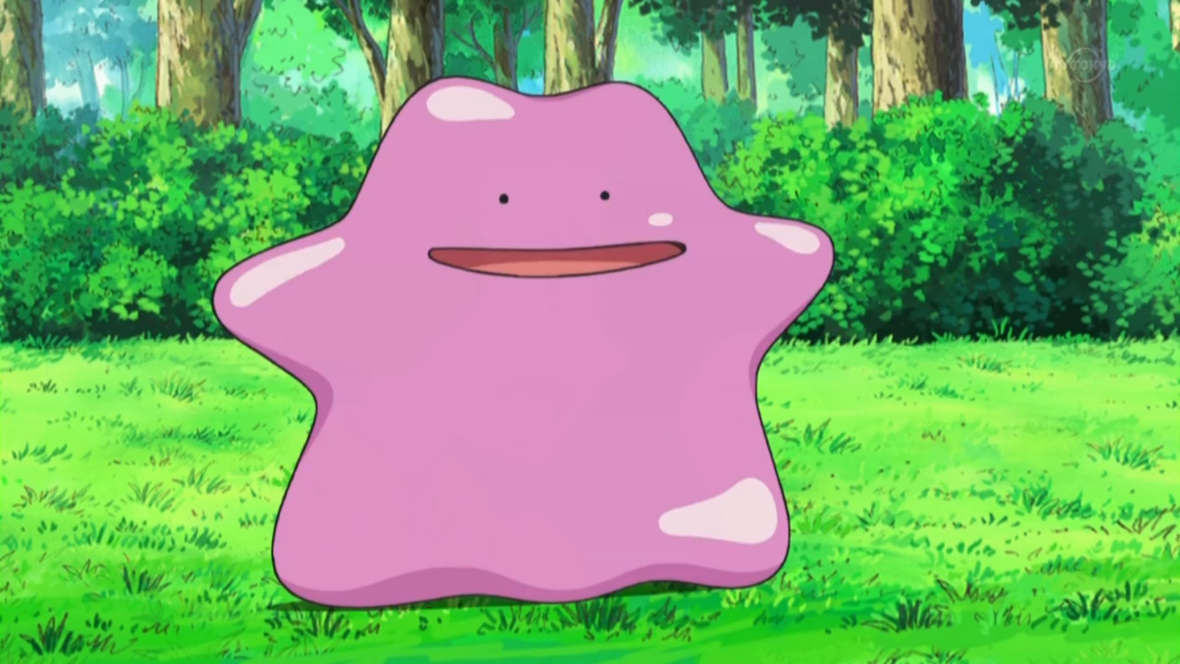
Ditto’s Great Adventure
By Allen Mo, Jonathan Chen, Benjamin Suh

Slide 2
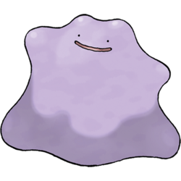
Who are you?
You are a pokemon named Ditto
Ditto is the transform Pokemon
Ditto is only able to transform into other Pokemon

Slide 3

What is your goal?
There is a rumored Rare Candy in a hidden area on the map
Your goal is to find the Rare Candy to win the game
There are various obstacles in your way to prevent you from finding the final room with the rare candy
The game is also open world

Slide 4

What can you do?
Move: MoveNorth/n, MoveSouth/s, MoveEast/e, MoveWest/w
View: ViewInventory, ViewStatus, ViewTransform,
Transform
Look
Pick
Use

Slide 5
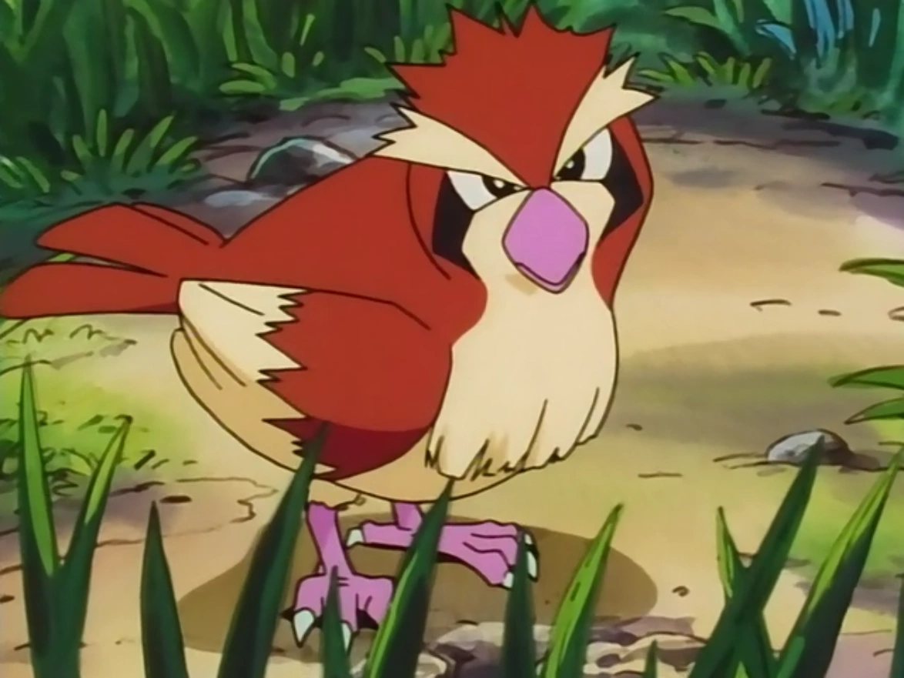
Pidgey?
The nice guy Pidgey will teach you to transform into him and fly over your first obstacle

Slide 6
Transform?
There are various Pokemon that you can transform into
Such as:
Pidgey for flying
Lapras for swimming
Sandslash for Cut or Rock Smash

Slide 7

What is PP?
PP short for Power Points
What do Power Points do?
Power Points are the number of times you can use an ability
How do you refill them?
You need to find PP Restore’s to refill your Power Points 2 points

Slide 8
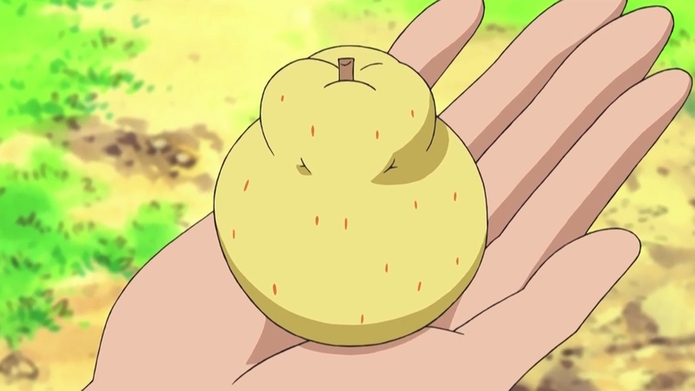
What is a Sitrus Berry
A Sitrus Berry is a berry that heals 20 health.
The Sitrus Berry can be used for Currency as well

Slide 9

What is this Snorlax?
Snorlax is the sleeping Pokemon “The Final Boss”
Be careful if you anger the Snorlax. He will ask for compensation
To wake him up without angering him, you will need a PokeFlute

Slide 10


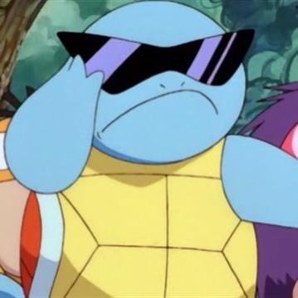
Where can I find the PokeFlute?
To find the PokeFlute, you will need to find Squirtle who will give it to you
But make sure you have the Zubat transformation otherwise it might cost you
To get the Zubat transformation you need to let Zubat Leech Life you 3 times

Slide 11

Rare Candy
Once you get the Rare Candy, you win the game

Slide 12
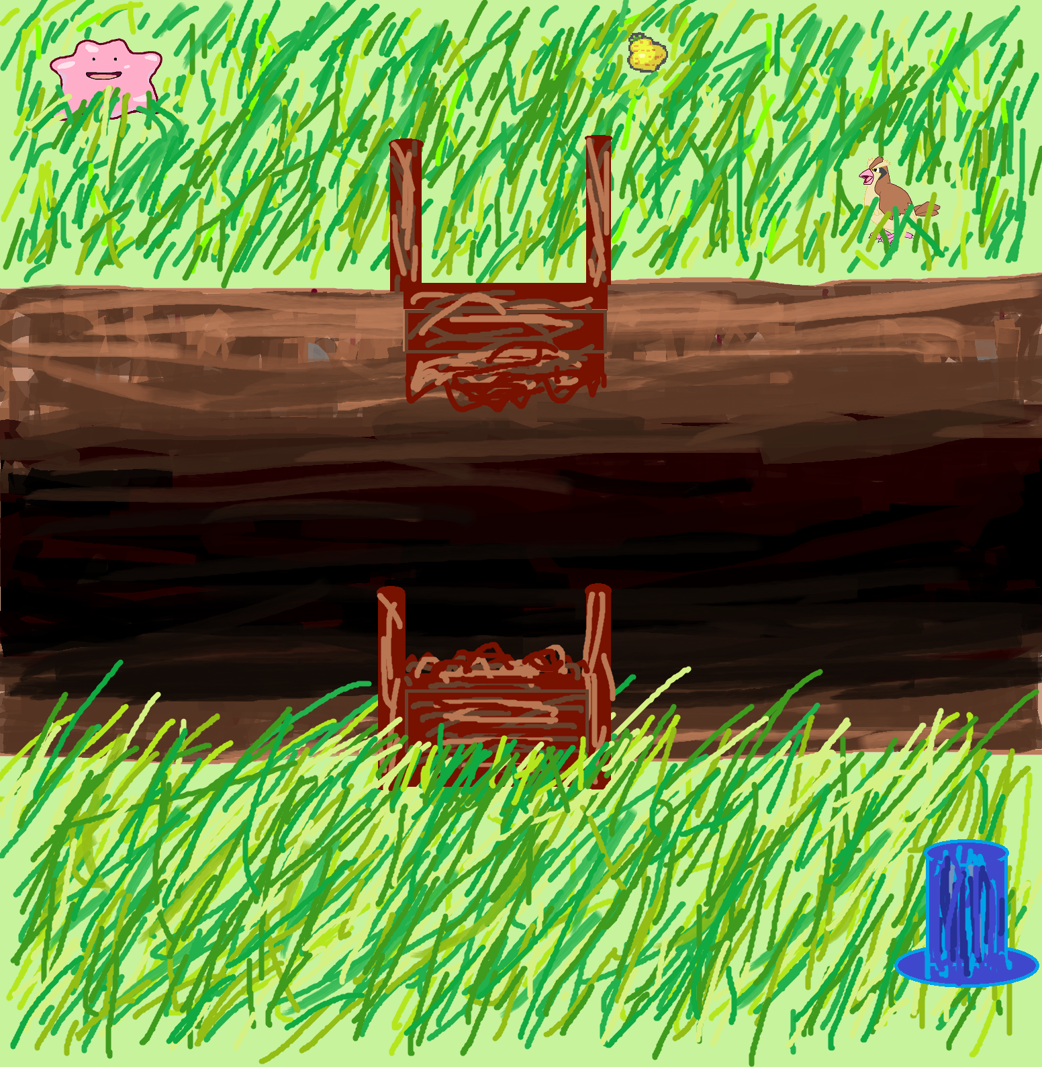
The Beginning

Slide 13
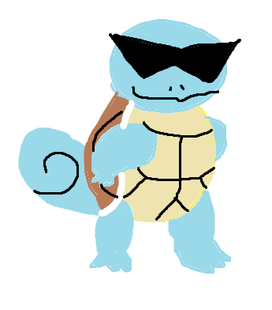
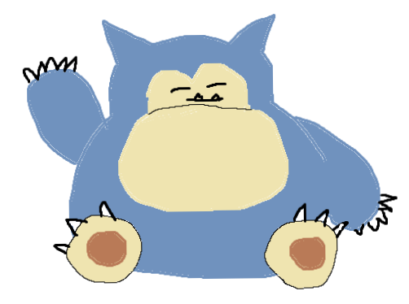
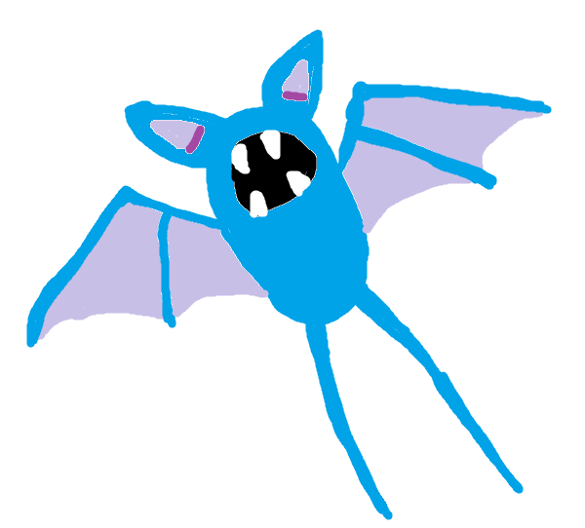
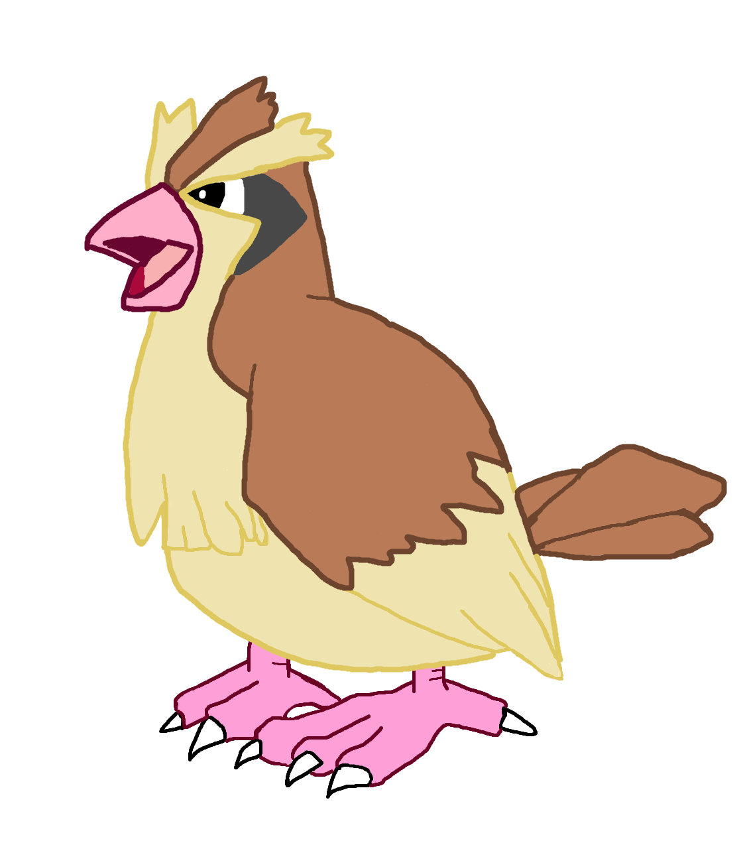

Now to the Game Demonstration!
Fortune telling is a business
Ayy play my game
…...
I’m a nice guy

